Slide 1
Project Title :
Vehicle Price Prediction through Automatic Licence Plate

Slide 2
Outline
Abstract and Scope of the Project
Implementation Details
Test Plan and Strategy
Results and Discussion
Conclusion and Future Work

Slide 3
Abstract and Scope
Abstract
“Vehicle Price Prediction through Automatic Licence Plate Recognition System” is to develop an Android application that allows to recognize the license plate of a vehicle quickly and easily with the camera of a smartphone or tablet, the app recognizes license plate within the camera image and uses the information to extract the registered details of the vehicle with the Regional Transport Office through web scraping and processes these details to predict the current price of the vehicle.

Slide 4
Abstract and Scope
Scope
● License Plate Recognition System majorly consists of the four major processes: Acquiring the image, Localizing the number plate, Segmenting and Recognizing Characters.
● The digits recognized are processed to extract the vehicle’s registered information with the e-pravahan agency.
● Retrieving the information such as Chassis No.,◈ Engine No.,◈ Owner Name,◈ Vehicle Class,◈ Fuel Type,◈ Vehicle Maker/Model,◈ Registration Upto, and ◈ Insurance expiry date.
● Feature extraction of the vehicle price prediction dataset.
● Predicting the price of the vehicle with high accuracy.

Slide 5
Implementation Details
Modules used:
Module 1 -: Scanner: Scans Image from camera
Module 2-: Plate Recognition: Recognizes Characters from the image through API calls.
Module 3-: Fetch Details: Fetch details through API Call.
Module 4 -: User Input: Get the fuel price as input from the user.
Module 5-: Price Prediction: Predict the price and display it to the user.

Slide 6
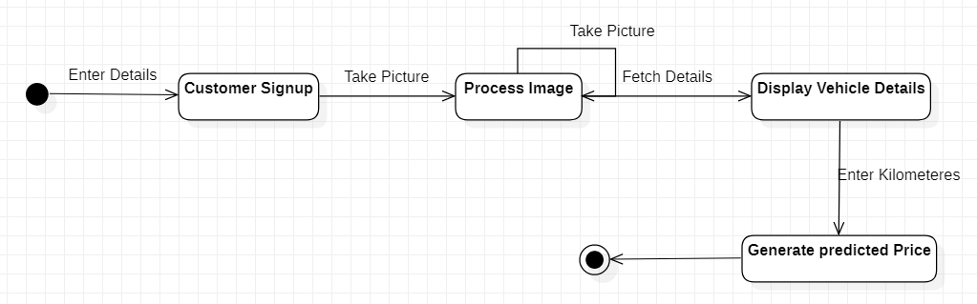
Implementation Details

Slide 7
Implementation Details
Plate Recognition-: When an input image is passed the following tasks-:
Convert it into grayscale
Apply edge detection , window filtering, and heuristic methods to identify the number plate region.
Perform Character Segmentation
With the use of support vector classifier recognize the segmented characters and store them

Slide 8
Implementation Details
Fetch Details-: Here an API call to Vehicle Info India -Programmable web is made by passing the registration no. and we are able to get the following details-:
Model No.
Company Name
Fuel Type
Transmission Type
Vehicle Type
Owner Type

Slide 9
Implementation Details
Used Car Price Prediction - inputs for this model is the output of the previous model i.e vehicle details.
Parameters used are year, kilometer driven, owner type, fuel type and transmission type.
TensorFlow is used to observe dependencies between the given parameters and selling price of vehicle.

Slide 10
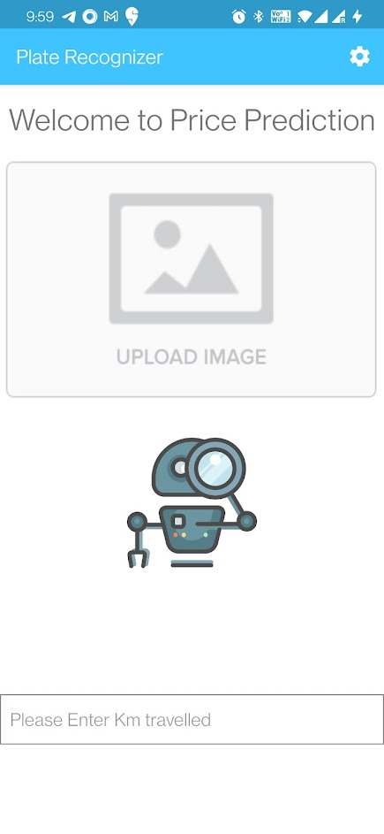
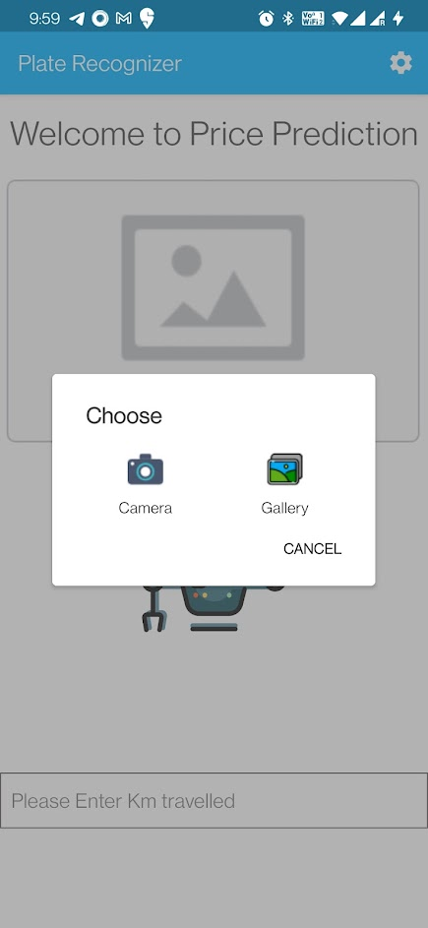
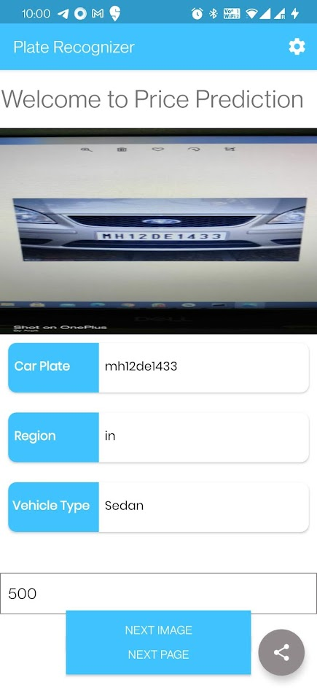
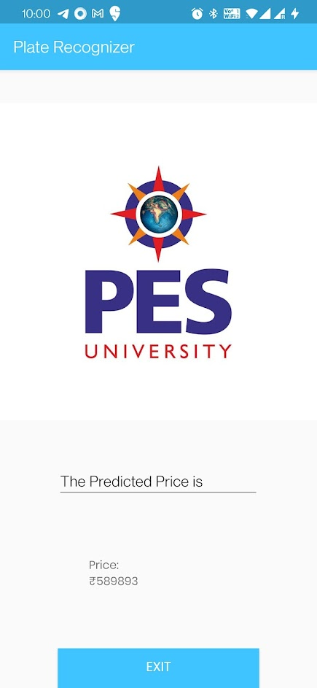
Project Demonstration

Slide 11

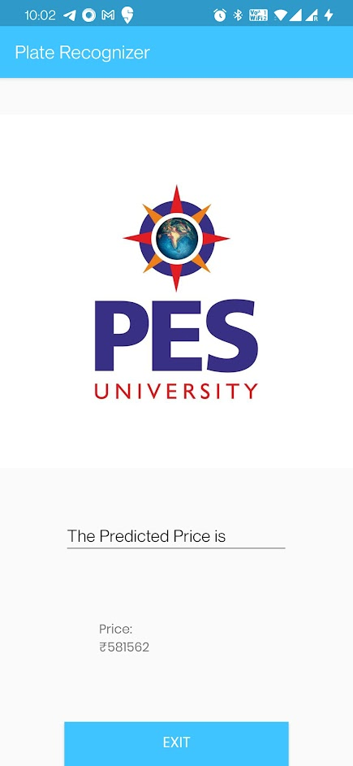
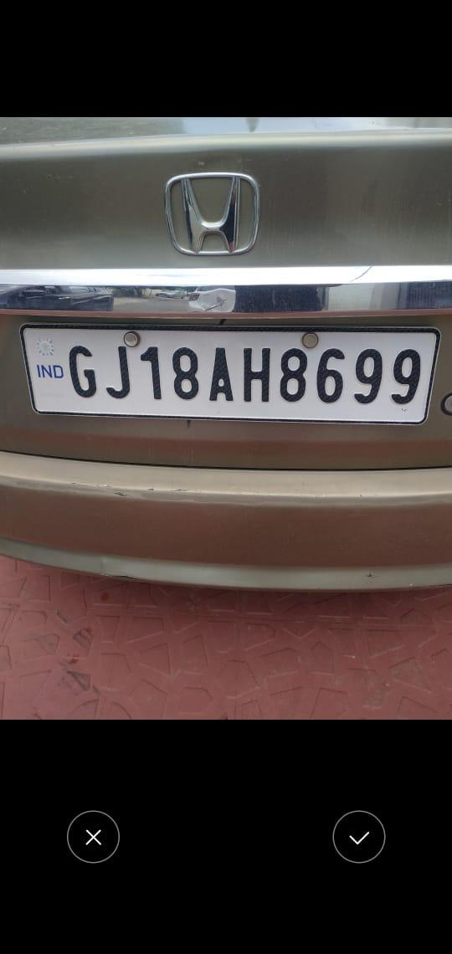
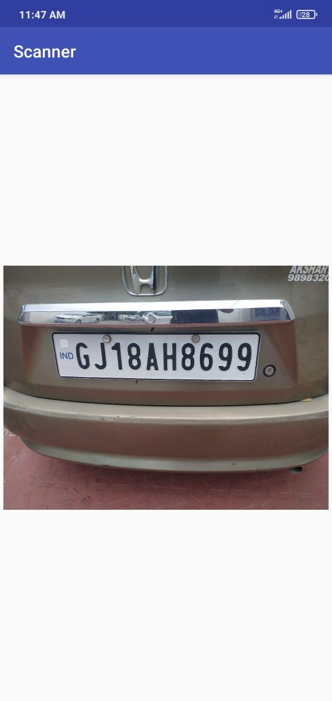
Project Demonstration

Slide 12
Test Plan and Strategy
Plate Recognition Model-: This model was tested for more than 250 images and it was able to recognize the license plate no. with more than 96% accuracy the model even works on blurred images.
Price Prediction Model-: This model was test tested on 20% of the data of whole dataset. The predicted price usually distributed in range [Actual Price +1,00,000].
Android App-: The android app was tested for unit and integration testing to ensure smooth functioning and handle any exception while taking user input.

Slide 13
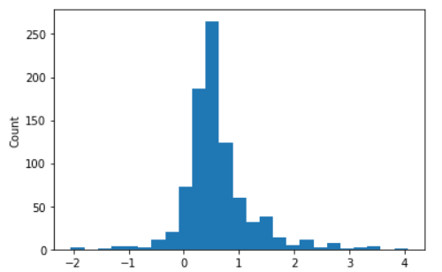
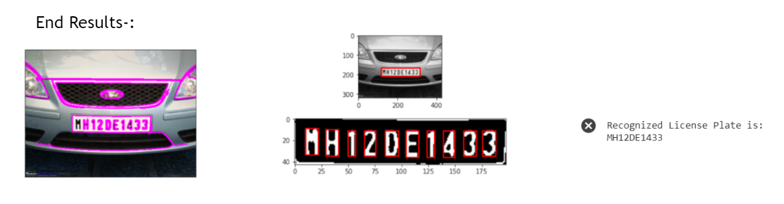
Results and Discussion
Price Prediction Result:

Slide 14
Conclusion and Future work
Improve the accuracy of price prediction model, the predicted price usually distributed in range [Actual Price +1,00,000] and therefore we would like to explore new techniques to improve our model.
Licence Plate Recognition model can be further modified to read characters to two-lined number plates.

Slide 15
References
The following journals were referred for the scope of the project-:
Abhishek Kashyap, B. Suresh, Anukul Patil, Saksham Sharma, Ankit Jaiswal, Soma Biswas. “Automatic Number Plate Recognition” 2018,ISBN: 978-1-5386-4119-4
Used Car Price Prediction using K-Nearest Neighbor Based Model By-K. Samruddhi, Dr R.Ashok KumarVol. 4 (3), 2020
Vishal Jain, Zitha Sasindran, Anoop Rajagopal, Soma Biswas, Harish S Bharadwaj, K R Ramakrishnan.
“Deep Automatic Licence Plate Recognition system” 2016 ACM. 2012, ISBN 978-1-4503-4753-2

Slide 16
Thank You

